Slide 1
Order-Processing Priority Rule (OPPR)
28th Oct 2020

Slide 2
What is order-processing priority rule?^{[1]}
Order-processing priority rule is a method used to decide which order will be processed first, where several orders are waiting to be processed. The orders waiting for processing are sequenced using one of many priority sequencing rules. It is assumed that the procurement can process only one order at a time.
The common metric is: FCFS (first come first served) thus the orders are serviced in the order they are received.
Other critical factors that must also be considered in order prioritization are;
SPT (Shortest Processing Time)
The job with the shortest processing time is processed first. This rule reduces work-in-process inventory, average order completion (flow) time, and average order lateness.
EDD (Earliest Due Date)
This rule is useful when the goal is to reduce order lateness. The order with the earliest due date is processed first.
CR (Critical Ratio)
A priority index is computed using the formula: CR = (due date — today's…)

Slide 4
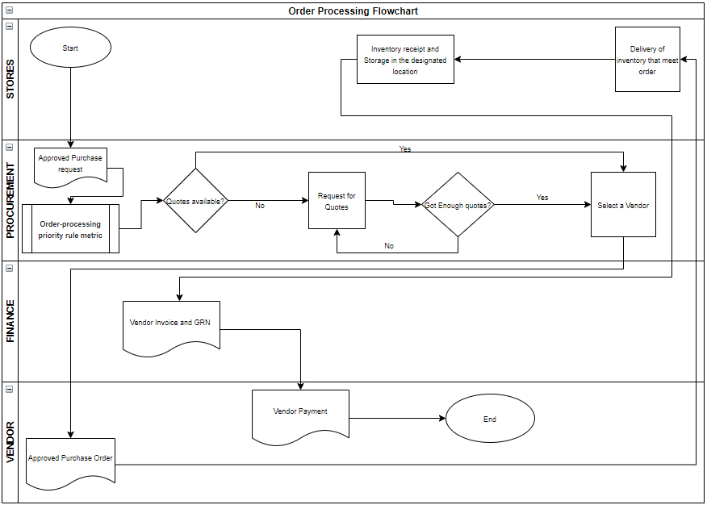
Order Processing Flowchart

Slide 5

Thank You.
k.dibogo@kokonetworks.com

